Slide 1

Game Hub
Christine, Claire, Ruby, Christopher, Gerard

Slide 2

Introduction
Our app allows users to search through all the games we have listed. The users can sign up and then once they are a user they can favourite certain games and be kept up to date with the latest news posts and new game releases.

Slide 3

The gaming industry
The gaming industry has taken over the last few years and is so popular. The are so many different consoles with so many different games that can be played.
The global games market has Reached £82.4 Billion in 2017. This shows that gamers across the globe have generated £82.4 in game revenues this year.
People spend approximately 3 Billion hours per week playing video games.

Slide 4

Our apps purpose
The main aims of our app is to let the users search through our collection of games, they can see the news feed and be kept up-to-date with release dates of new games.
Also the users can sign up for an account and then they can favourite upcoming games of interest.

Slide 5

What the users can do
A general user can see a general games feed and can sign up for an account
When logged in the user can then favourite different games.
There will be a section for the admins, with that they can add, edit and delete the games and posts.
There is also a part for super admins, which can do all the same actions as a normal admin but also they can remove account holders and other admins.

Slide 6
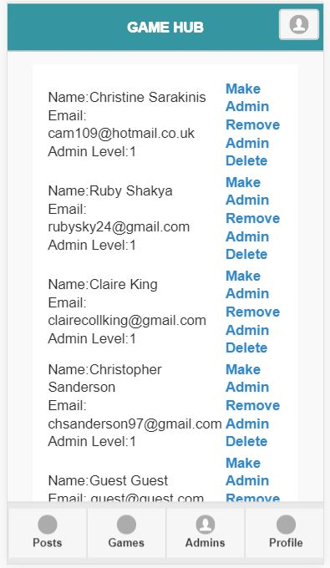
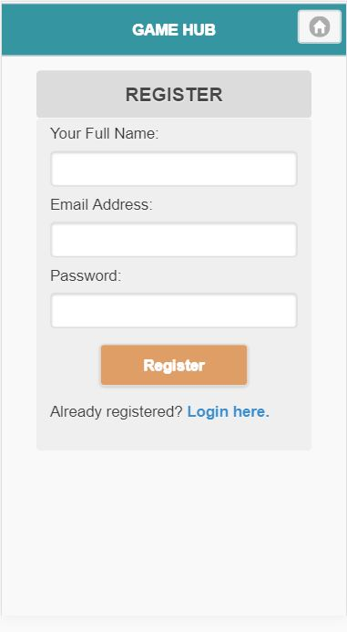
Our app
These are screenshots of our app. The first one is of the admins section and that shows that a super admin can remove an admin or make someone an admin.
The second one is the register form for a user t register for an account .

Slide 7
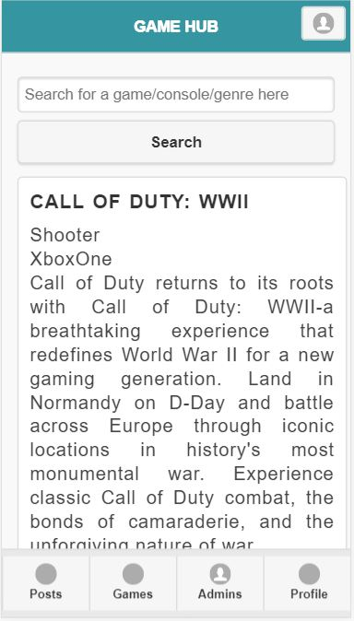

Our app
The screen shots show the games list, the fist screen shot is of the general home page.
The second screenshot is to show a game that has been favorited.

Slide 8

Future development
Within our app we agree that a section for feedback from the users would benefit the app.
Also, a section for prices and places to buy the games. We feel this would benefit the users so they don’t need to hunt around for a place to buy the game thy want.
Another section to work on would be the editing user details, in case any of the details need changed.

